Slide 1
Data Analytics Team Operational Framework
We design a operational framework that describes:
The team's workflow
How the team cooperates with other departments
The way we manage internally
How we protect ourselves from data leak

Slide 2

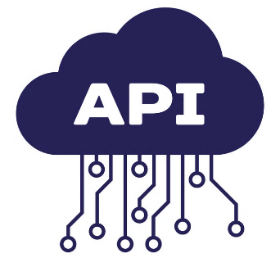




Workflow
3
Stage 3: Handover
When the sub-project gets approvals from the Committee (in case of data modeling) or passes the test of users (in case of automation tools), The output will either be regularly post to API or to shared folders through module “post_phs”. The API is the environment where Data Analytics Team and IT department interact without the need of a common programming language. IT department can send a get-request to this API and pull all model’s results back to the company’s system.
Stock Exchange
IT Department
post_phs
request_phs
SQL Server
pull/push mechanism
3
request_phs
post_phs
Bloomberg Terminal
Data Analytics Team
GitHub Platform
Shared Folders
2
Stage 2: Modeling & Coding
At this stage data analytics models or automation tools are built (depending on the purpose of current sub-project). At the end of the day, every team member should commit their codes and send a pull request to the GitHub platform to get their work reviewed. In case of approval, their work will merge into the main branch of the developing sub-project. If declined, it should be re-written and the submit/review process restarted.
request_phs
FiinPro Terminal
1
Stage 1: Data Extraction
Data are extracted through module request_phs and stored in the team member’s local computer. This member will then commit and push this data to the shared GitHub platform. With the approval from the team leader, this data will incorporate in the cloud.
Data sources

Slide 3


The way our team cooperates with other departments
Deployment
Management's approvals for IT to grant Data Analytics Team necessary access to database
IT Department
Raw Data Input or Database Access
Delivery
Management assigns task to Data Analytics Team.
Constructive feedbacks are also frequently made to ensure mutual alignment
Top Management
Data Analytics Team
Constant feedback and constructive communication to ensure mutual alignment
Delivery
Practical Usage
Functional departments reach out Management to requests Data Analytics Team to do a particular task.
Functional Departments

Slide 4
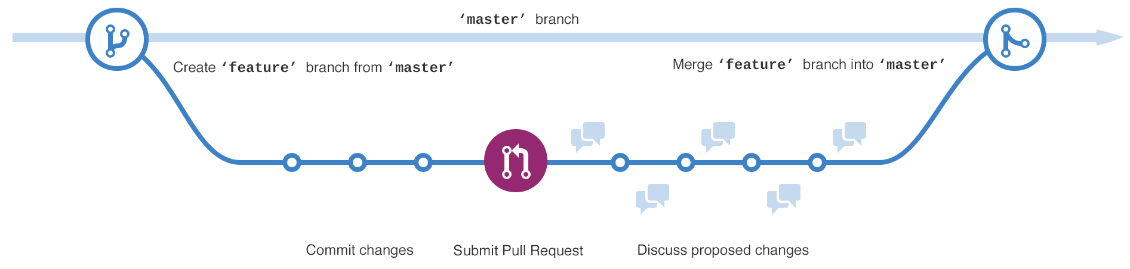
The way our team managed internally
Send feedback and request to re-write declined codes
There is always a single version of project maintained in platform.
At the beginning of the day, each team member should send a request directly to the platform to clone the latest version of project to their local computers.
During the day, they write their code locally as usual.
At the end of the day, they are required to submit their codes by sending a pull request to the platform. The platform will notify the team leader about this submission and display a comparison between the latest version and the newly-written codes.
If the code is approved by the team leader, it will be incorporate to platform and becomes the latest version. If it’s declined, it will be sent back the submitter to re-write, and the submit/review process restarts.
Team Member
Team Member
Send pull request to get the codes reviewed
Push approved codes to the main project
Receive and review all pull requests
GitHub Platform
Team Leader
Team Member
Team Member

Slide 5
How we protect ourselves from data leak but ensure efficiency
Team Leader
Authorization Table
Level 3
 | USB Portal (1) | Web Browsing (2) | Email (3) | Server Username (4) | Base (5)
Level 1 | Prohibited | Allow specified websites only | Prohibited | Dynamic (expire at 5:00PM everyday) | Prohibited
Level 2 | Prohibited | Allow specified websites only | All internal emails with attachment will cc to Team Leader & Head of RMD automatically. Sending emails to external address is completely blocked. | Dynamic (expire at 9:00PM everyday) | Permit access via intranet only
Level 3 | Prohibited | All websites excepts drives, messenger apps, personal emails | Fully permitted | Full-time Access (permanent account) | Fully permitted
Level 2
Level 2
Officer
request_phs
Level 2
(module)
Level 1
Team's Database
Level 1
Intern
Level 1
(1) Staff of all levels are prohibited from using USB and external hard-drives.
(2) Interns and officers are only permitted to certain approved websites that directly support their work (Team Leader shall prepare a list of these websites). Team Leader is permitted to access to most websites for necessary reference. However, all kinds of social media, data drives, messaging platforms, personal emails are prohibited from staff of all levels.
(3) Interns are not registered for a company email, they are not able to send/receive emails during their entire internship. Officers have Outlook email but anytime they send out attachment to internal email addresses, that email will cc to Team Leader & Head of RMD immediately. They are blocked from sending emails to external addresses. Team Leader has full use of email to ensure the team's communication with other departments.
(4) Every team members are provided an SQL Server username to extract the data. However the password of intern's accounts and officer's accounts expire at 5:00PM and 9:00PM everyday, respectively. This mechanism is to ensure that they will not be able to access to the database out of work without supervision of the Team Leader. Team Leader has full-time access to the database to conduct heavy analysis that might be left running over-night.
(5) Interns have no Base accounts. Officers do have Base account but only permitted to login via company's intranet, which means they cannot use Base out of the office. This mechanism is to ensure that they cannot upload files to Base apps and download those files later from personal devices. Team Leader is fully permitted to use Base.

Slide 6
Thêm 1 slide về quy tắc chung: những dữ liệu nào tuyệt đối không được đụng vào (email, sđt,…) để nói lên được trong TH dữ liệu bị lọt ra ngoài thì không thể sử dụng được
Nói cụ thể về có 2 server, mirror dữ liệu vào ban đêm, chỉ những trường dữ liệu nào được approved với 2 sếp mới được mirror

Slide 7




THANK YOU
Hiep Dang
+84 912 801 714
hiepdang@phs.vn
www.phs.vn

